Slide 1
LET’S ’SHINY’ IT UP:
DEVELOPING A WEB-BASED INTERACTIVE TOOL FOR DANISH TEXT ANALYTICS USING RSHINY

Slide 2
RESEARCH PROBLEM
Research problem: The field of Danish natural language processing (NLP) is highly limited by the fact that only few accessible language processing tools exist (Kirkedal et al., 2019; Strømberg-Derczynksi et al., 2020)
Project goal: Addressing the problem that only individuals with programming skills seem to benefit from advanced NLP technologies. The goal of this project is to make Danish NLP analytical tools accessible through a web-based Shiny application.

Slide 3
WORKFLOW AND PROOF OF CONCEPT
1
2
TRAINING THE MODEL ON DANISH GIGAWORD CORPUS
A lot of preprocessing of data (Danish Gigaword Corpus) using UdPipe Package in R:
NLP: Tokenization, Parts of speech tagging, Lemmatization, Dependency Parsing
Lowercase
Remove punctuations
Remove numbers
Remove Danish stop words
2. Training the model in Python using the Gensim module
PROGRAMMING THE RSHINY APPLICATION
Learning how to use Rshiny
Deciding which functions should be applicable
Designing the app and implementing the functions in a user-friendly manner

Slide 4
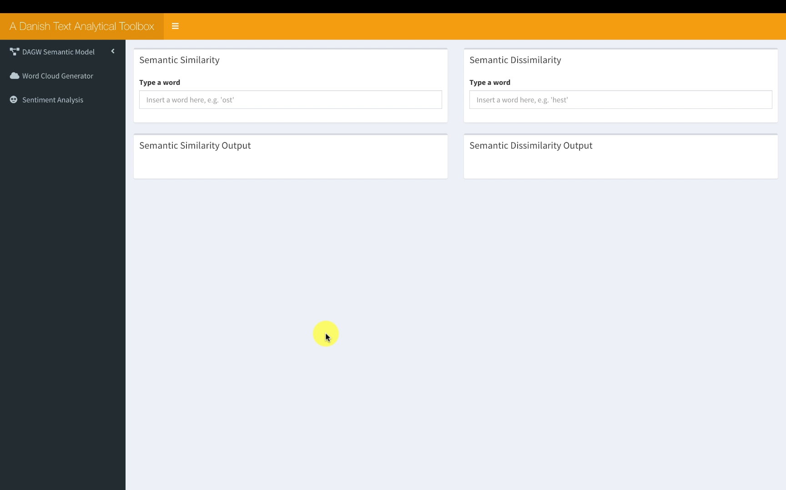

Slide 5
CULTURAL RELEVANCE: IMPACT AND BENEFIT
Bringing more quantitative language analytical methods into the humanities
Making NLP tools accessible for academics that do not possess the necessary programming expertise
Contributing with more Danish NLP resources

Slide 6
CREDITS AND REFERENCES
Github Repository: https://github.com/sofieditmer/CulturalDataScienceExamProject2020
Contributors: Astrid Nørgaard Fonager
Software and literature:
Ian Fellows (2018). wordcloud: Word Clouds. R package version 2.6. https://CRAN.R-project.org/package=wordcloud
Jan Wijffels (2019). udpipe: Tokenization, Parts of Speech Tagging, Lemmatization and Dependency Parsing with the 'UDPipe' 'NLP' Toolkit. R package version 0.8.3. https://CRAN.R-project.org/package=udpipe
Jan Wijffels (2020). word2vec: Distributed Representations of Words. R package version 0.3.0. https://CRAN.R-project.org/package=word2vec
Kirkedal, A., Plank, B., Derczynski, L., & Schluter, N. (2019). The Lacunae of Danish Natural Language Processing. In Proceedings of the 22nd Nordic Conference on Computational Linguistics (pp. 356-362).
Lauridsen, G. A., Dalsgaard, J. A., & Svendsen, L. K. B. (2019). SENTIDA: A New Tool for Sentiment Analysis in Danish. Journal of Language Works-Sprogvidenskabeligt Studentertidsskrift, 4(1), 38-53.
Mikolov, T., Chen, K., Corrado, G., & Dean, J. (2013). Efficient estimation of word representations in vector space. arXiv preprint arXiv:1301.3781.
Python Software Foundation. Python Language Reference, version 2.7. Available at http://www.python.org
RStudio Team (2019). RStudio: Integrated Development for R. RStudio, Inc., Boston, MA URL
http://www.rstudio.com/.
Strømberg-Derczynski, L., Baglini, R., Christiansen, M. H., Ciosici, M. R., Dalsgaard, J. A., Fusaroli, R., ... & Ladefoged, C. (2020). The Danish Gigaword Project. arXiv preprint arXiv:2005.03521.
Winston Chang, Joe Cheng, JJ Allaire, Yihui Xie and Jonathan McPherson (2020). shiny: Web Application Framework for R. R package version 1.5.0. https://CRAN.R-project.org/package=shiny

